Slide 1
Autonomous Car
Made By:
Omar Abdelzaher Agina
Loujayne Ashraf Khalil

Slide 2
Outline
Introduction
What’s autonomous car ?
Our objective
Solution
Technical Approach
Simulation on Proteus
Flowchart
Code
Outputs

Slide 3
Introduction
Automation can help reduce the number of crashes on our roads.
WHO reports that 1.35 million people die in car accidents per year globally
Accidents increases at nighttime and long weekend driving
Drivers aged 70+ have higher crash death rates

Slide 4
What’s autonomous car?
Partially or fully drive themselves and which may ultimately require no driver at all.
To make cars safer, drivers more aware, and accidents less likely.
The technology appears close to maturity and commercial introduction.
Reducing the opportunity for human error

Slide 5
Our objective
Modulate a RC car to handle three tasks:
Self-driving on the track.
Barrier detection.
Front collision avoidance.

Slide 6
Solution
Decreases number of accidents
Lessens traffic jams
Time-saving vehicle
Accessibility to transportation for elderly or disabled person

Slide 7
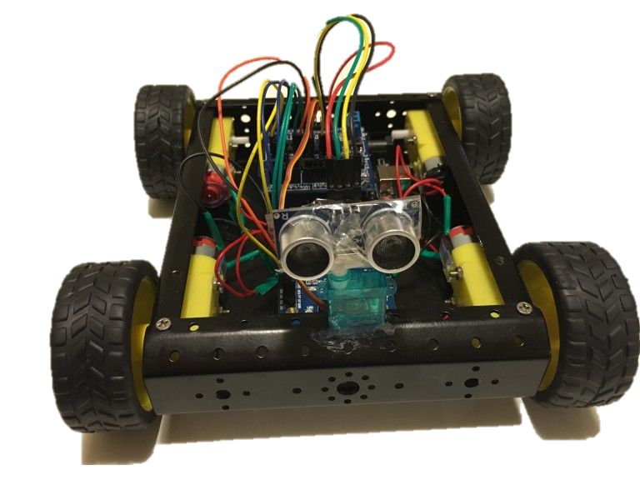
Technical Approach

Slide 8
Setup Components
ATMega32 microcontroller
Ultrasonic HC-SR04
16x2 LCD
L923D
2 x DC Motor
Servo Motor

Slide 9
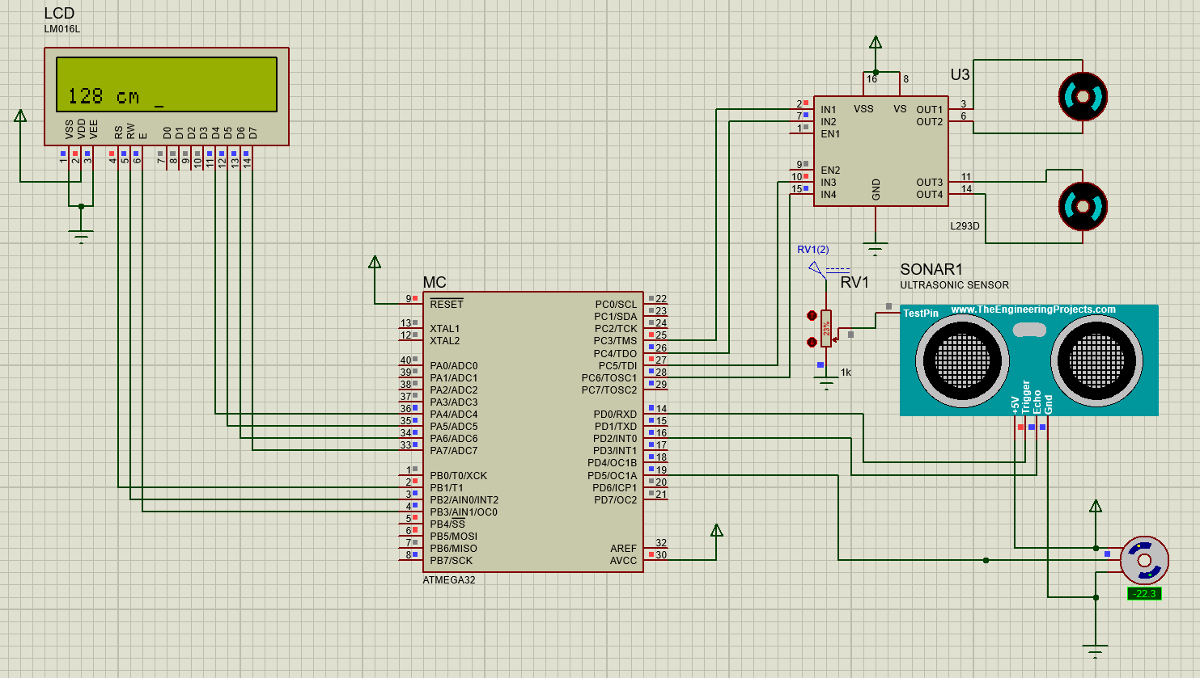
Simulation on Proteus

Slide 10
Flow Chart
Initial state
Forward
Servo rotates left
Turn left
Servo Rotates Right
Turn Right
Move Backward
Distance >30
Distance <30
No obstacle
Obstacle
No Obstacle
Obstacle
No Obstacle
Obstacle
Turn Right
Turn Left
Return to Initial State

Slide 11
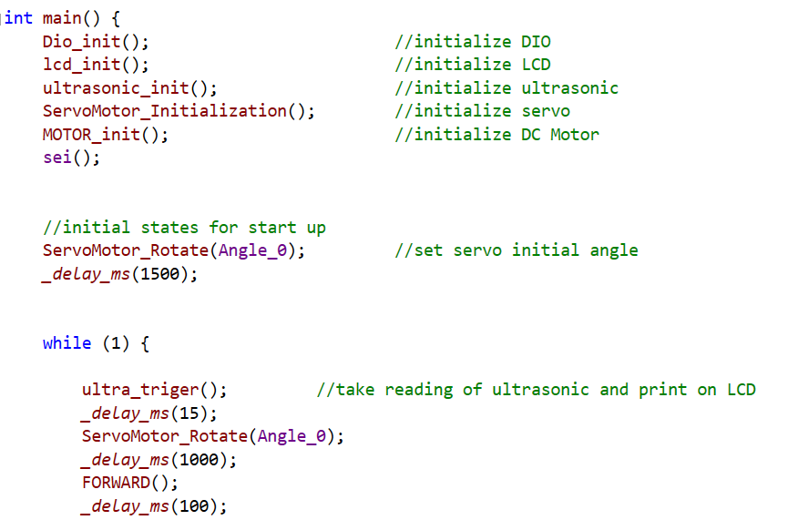
Code

Slide 12
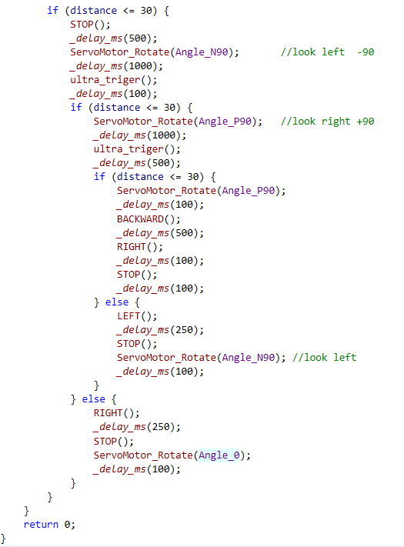
Code

Slide 13
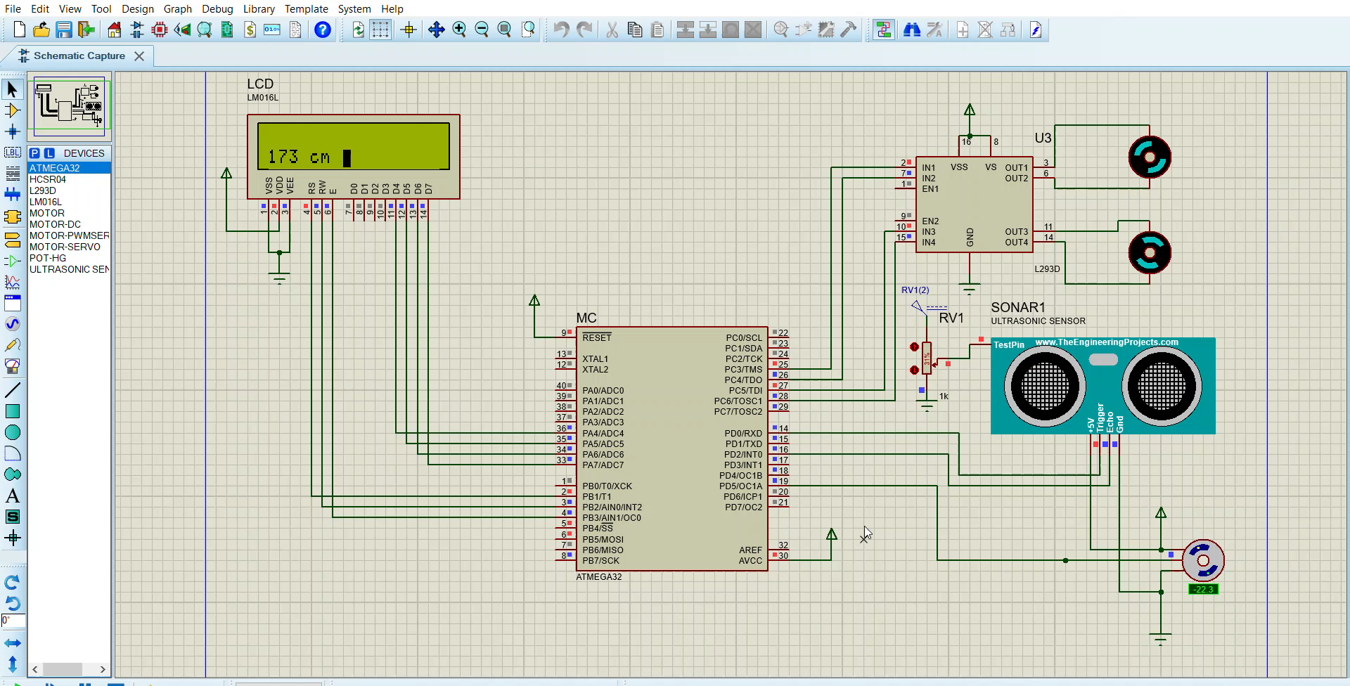
OUTPUTS

Slide 14
Any Questions?
THANK YOU!!

